Slide 1
Modelling product structures by generic bills-of-materials [D]
Literature Report
(EELCO A. VAN VEEN, Technische Universiteit Eindhoven, 1991 )
Li. 2019.11.29

Slide 2
Introduction & Problem Formulation
Generally speaking, production control described as follows: “..the coordination of supply and production activities in manufacturing systems to achieve a specific delivery flexibility and delivery reliability at minimum costs.” (Wijngaard and Wortrnann, 1990).
To be specific, improving production control systems to meet requirements on price, delivery lead time, reliability, and customer requirements with regard to the specifications of a product.
In oder to support the production control function, the information system, so as called Production Control Information Systems (PCIS) or Material Resource Planning (MRP), are designed to support.
As the core data of the information system, the Bills-of-Material is one of the major concern in recent research.

Slide 3
Contribution & Organization of the thesis
The contribution of this thesis will be:
To develop a terminology and a set of concepts which can be used to describe BOM-processors which are specifically developed to deal with large product variety.
To develop improved concepts for BOM-processors for representing product data and product structure data in case of very large product variety.
The structure of the thesis:
Chapter 2 describes the way in which BOM are represented in MRP;
Chapter 3 describe PCIS requirements and characteristic place on BOM;
Chapter 4 explores the problems of BOM in the case of large product variety;
Chapter 5 introduces a framework for obtaining the BOM;
Chapter 6 literature review of BOM generating systems;
Chapter 7 and 8 analyses concepts and discuss the major shortcomings about BOM;
Chapter 9-11 devoted to a new concept in BOM theory, namely the Generic BOM;
Chapter 12 case study;
Chapter 13 summaries and conclusions of this research;

Slide 4
PCIS in a historical perspective
In the sixties, an information system was composed of a number of stand-alone applications;
In the seventies, DBMS were developed and data was pushed out of the applications;
In the eighties, UIMS enabled application developers to push the user interaction out of the applications;
In the nineties, WFMS allowed for the definition, execution, registration and control of workflows;
In the 20th, Internet-based and Cloud-based technologies was applied in PCIS;

Slide 5
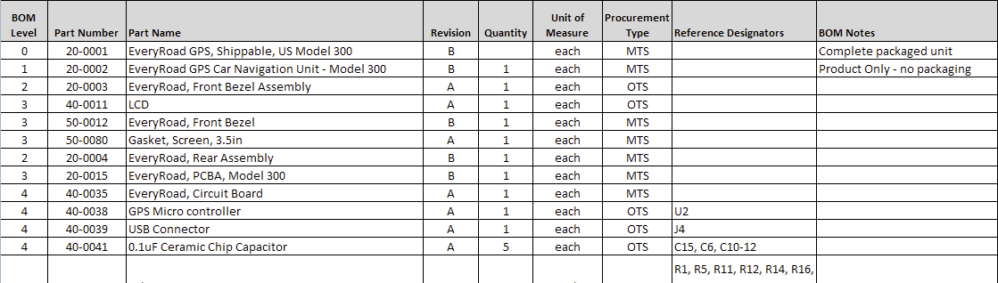
BOM definition and modelling
The Bill-Of-Materials (BOM) is a parts list which often used in manufacturing to capture the structure of the products to be produced. (Orlicky, 1972. Buffa and Sarin, 1987)

Slide 6
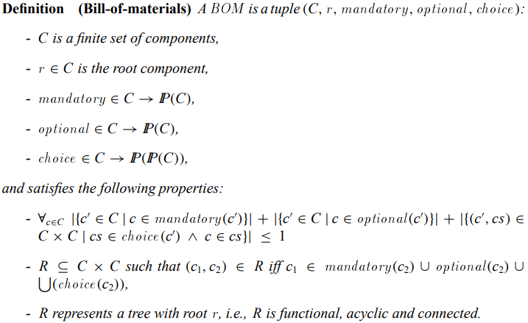
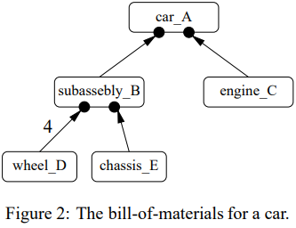

BOM definition and modelling
Skylight
Four cylinder
Eight cylinder

Slide 7
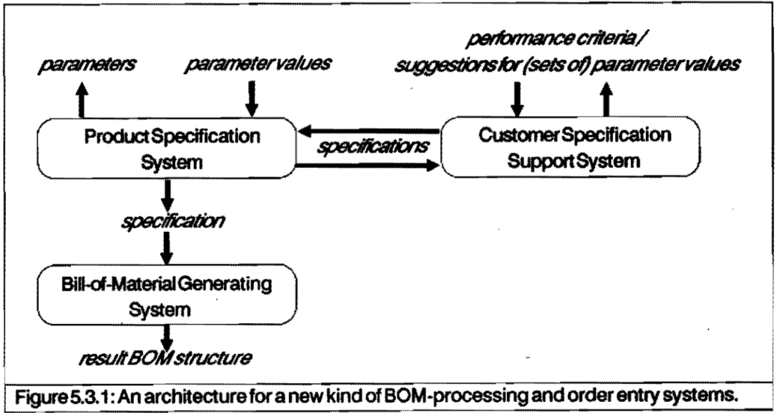
Architecture for BOM processing system

Slide 8
Architecture for BOM processing system
The Product Specification System (PSS): to evaluate whether a given specification S is valid, semi-valid or invalid against a particular item A.
The Bill-of-Material Generating System (BGS): to generate a BOM, given an item A and a valid specification against A.
Customer Specification Support System (CSSS): to advises the values which produce the specification of the product type which is most suitable for him or her.
The process of BOM generation process can be described like this: the CSSS creates the specific parameter values based on the user’s requirements. According to these parameters the PSS provides the valid specification. The BGS generate the result BOM structure finally.

Slide 9
The Customer Specification Support System
The CSSS is to alleviate the dilemma between product specification or parameter values and product properties or performance.
Two extreme types of support can be envisaged for a CSSS are:
Evaluation support. The CSSS evaluates a given specification on a number of performance criteria, and does not generate suggestions for selecting particular parameter values.
Generative support. The CSSS should determine which product properties are required and accordingly which parameter values should be selected. It will be difficult due to the customer requirements unambiguously and complex relationships between performance criteria and parameter values, parameter values themselves as well.
The critical point is how to evaluate the product performance based on each alternative specification. For instance:

Slide 10
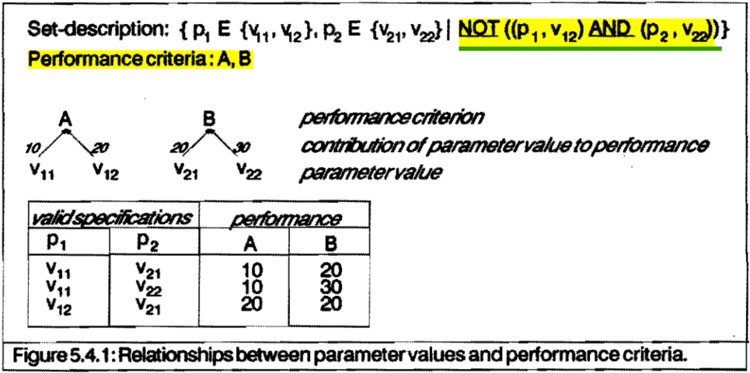
The Customer Specification Support System
Obviously the specification {(P1,V11), (P2, V21)} yields the poorest performance, whilst whether the specification {(P1, V11),(P2,V22)} or {(P1, V12), (P2,V21)} should be advised is dependent on which performance criterion is perceived as more important. Weighting the performance criteria is the most common measure.

Slide 11
The Product Specification System
The primary function of the Product Specification System (PSS) is to support the composition of valid specifications.
The following three aspects characterize the type of support which can be provided:
Composing a specification. As for different individual, parameter are presented relying on the sequence parameters which has been determined first.
Validating a specification. Concerning which specification is validated. Two basically different approaches can be followed, namely retrospective approach and anticipative approach.
Informing of consequence. Different parameters have a closely connection each other, thus, the specification process only presented those parameter values which do not produce an invalid specification, depend on the formal parameter. While there is an insuperable disadvantage to this approach, the end user cannot make weighted decisions boil down to he cannot get full insight into the available product variety.

Slide 12
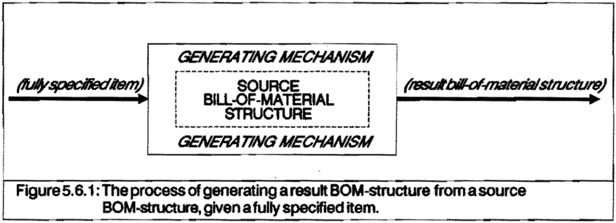
The Bill-of-Material generating System
The function of the BOM generating system (BGS) is to produce a result BOM-structure for a product type which is identified by an item with a valid specification.
The system which generates a result BOM-structure given a fully specified item and a source BOM-structure of that item.

Slide 13
The Bill-of-Material generating System
The BGS includes two basic elements:
The result bill-of-material structure.
Basically the result of the BOM generating process is a set of nodes (which represent fully specified items) and directed relationships between these nodes (which represent gozinto-relationships).
(2) The source bill-of-material structure.
In the source BOM-structure, X and component items of X may contain one or more product types. Not all gozinto-relationships which are defined for X in the source BOM-structure are relevant to all product types of X. Therefore, to obtain the result BOM-structure for a fully specified item X, gozinto relationsbips and items from the source BOM-structure must be selected and/or specified for the result BOM-structure.

Slide 14
Conclusions and Inspirations
Production Control Information System (PCIS) is essential for markets, and BOM is the core of PCIS;
The Bill-Of-Materials (BOM) is a parts list which often used in manufacturing to capture the structure of the products to be produced;
BOM-processing is constructed by Customer Specification Support System (CSSS), Product Specification System (PSS), BOM Generating System (BGS) as well;
CSSS is used in the order entry process to obtain a product type which is the most suitable for a particular customer;
PSS concentrates on the specification representation;
As for BGS, it should be possible to generate automatically the result BOM-structure for a product type identified by a fully specified item;

Slide 15
Reference
Van Veen E A. Modelling product structures by generic bills-of-materials[M]. Elsevier, 1992.
Van Der Aalst W M P. Designing workflows based on product structures[C]//Proceedings of the ninth IASTED International Conference on Parallel and Distributed Computing Systems, IASTED/Acta press, Anaheim. 1997: 337-342.
Hegge H M H, Wortmann J C. Generic bill-of-material: a new product model[J]. International Journal of Production Economics, 1991, 23(1-3): 117-128.
Blaha M R, Premerlani W J, Rumbaugh J E, et al. Method and system for automated bill-of-material generation: U.S. Patent 5,119,307[P]. 1992-6-2.

Slide 16

Q&A
Reference
Thanks

